Slide 1
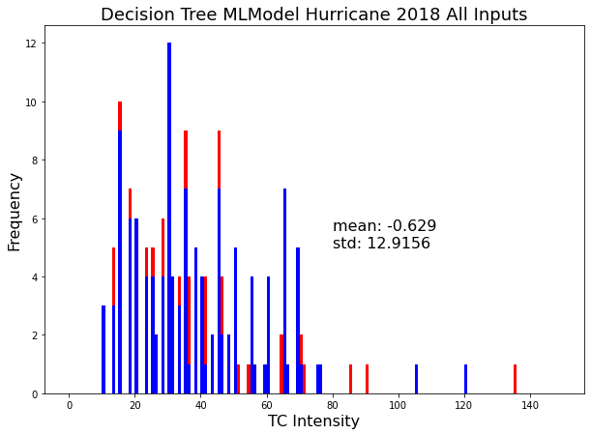
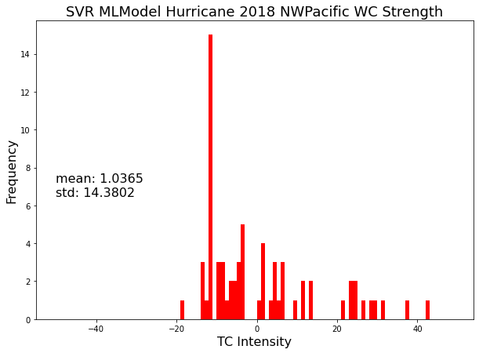
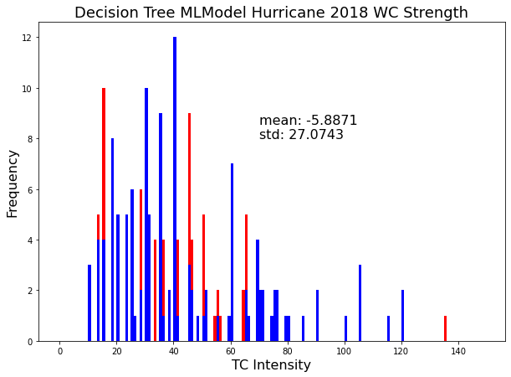
Estimation of Pacific and Atlantic Tropical Cyclones (TCs) Intensity from ATMS-Derived Temperature Anomaly using Machine Learning
Zichao Liang, Mentor: Dr. Lin Lin
ESSIC, University of Maryland College Park, MD, USA
Introduction/Motivation
Sparse distributed and employed instruments cause difficulty monitoring intensity of Tropical Cyclones
Previous studies show few successful methods of estimation of TC intensity from previous microwave sounders (ASMU-A, MHS)
ATMS (Advanced Technology Microwave Sounder) onboard JPSS satellites has advantages
PROBLEM: Estimation of TC intensity lacks in robustness and accuracy
PURPOSE: Tropical Cyclone losses are largely correlated with TC intensity, thus more accurate prediction of TC intensity will help contribute to better success of disaster warnings and lessen losses.
Results/ Future Work
Combined dataset using Decision Tree Regression with 5 inputs Date, time, Lon, Lat, and WC Strength had the best prediction with RMSE of 12.92, a MAE of 7.61, and a correlation coefficient of near 0.8. (Figure 1)
Future work may tell us that we would need to generate a longer period of data, so our models could be better fit to the data.
Methodology
DESIGN: We will use 3 machine learning algorithms to estimate TC intensity for Atlantic and NW Pacific Hurricanes in 2018: Linear Regression, Support Vector Regression, Decision Tree Regression
Datasets/Input features: HURDAT2: comma-delimited, text format with six-hourly information for known cyclones
TC Intensity: Saffir-Simpson Hurricane Wind Scale (noaa.gov)
To retrieve ATMS Temperatures (Tian and Zou 2016) study equation

